Slide 1


Acoustic Analysis Of Speaker Using Ansys
TEAM MEMBERS
SETHU PRIAN VM (927621BEC193)
BALAJI N (927621BEC022)
SRIHARI M (927621BEC211)
THIRUPUKAL G (927621BEC231)
GUIDED BY
Dr.MURUGAN,
ASSISTANT PROFESSOR,
ECE DEPARTMENT.

Slide 2
INTRODUCTION
Ansys Acoustics Analysis helps optimize sound from the first steps of product development. By applying this acoustic modeling software, you can have best-in-class tools at the ready to deliver top-quality user experiences that blend optimal functionality with pristine acoustics.
Acoustics is defined as the science that deals with the production, control, transmission, reception, and effects of sound (as defined by Merriam-Webster). Many people mistakenly think that acoustics is strictly musical or architectural in nature.

Slide 3
PROBLEM STATEMENT
The objective of this acoustic analysis using ANSYS is to comprehensively assess the performance of a speaker system. This analysis aims to address the following key aspects:
Sound Radiation: Determine the speaker's sound radiation pattern in different directions, including directivity and dispersion characteristics, to ensure optimal sound coverage and quality.
Frequency Response: Analyze the frequency response of the speaker to identify resonances, peaks, and dips in the output, ensuring that it meets the desired audio specifications across the entire frequency range.

Slide 4
OBJECTIVES
Vibration Analysis: Evaluate the structural integrity of the speaker components and their effect on acoustic performance. ANSYS can be used to study vibrations in the diaphragm, cone, and other parts, which can impact sound quality.
Modal Analysis: Identify the mode shapes and natural frequencies of the speaker system. This helps in understanding potential sources of resonance and how to mitigate them.
Material Selection: ANSYS can assist in choosing appropriate materials for the speaker components by simulating their acoustic properties. This can improve sound quality and efficiency.

Slide 5
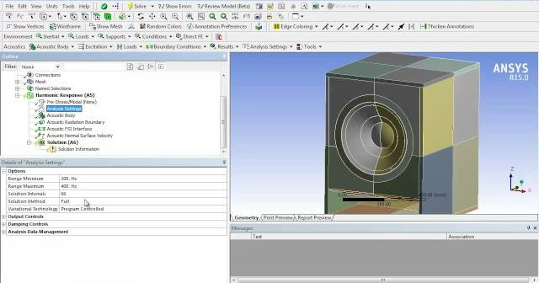
Existing System
Ansys Acoustics Analysis helps optimize sound from the first steps of product development. By applying this acoustic modeling software, you can have best-in-class tools at the ready to deliver top-quality user experiences that blend optimal functionality with pristine acoustics.

Slide 6
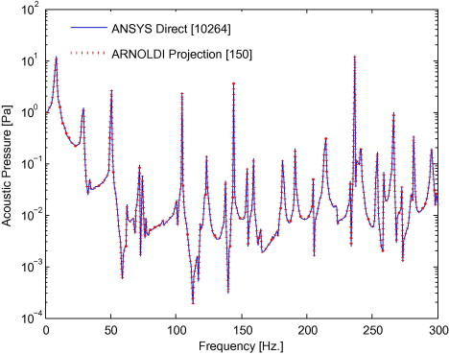
Comparison
The frequency is around the ideal value and it is equal to 0.02 at 5.8 GHz. Furthermore, it is clear from the same figure that the frequency is less than 0.1 over the operating frequency band.

Slide 7
Conclusion
Speech is basic mode of communication between human
beings, so a feasible interface is required to connect human
with machines. Although this field has gained a wide approval
to automate the services and applications but there are several
parameters which affect the accuracy and efficiency of speech
recognition system. The most of speech variability involves
speech rate, environmental conditions, channel and context of
utterance. Robustness of speech system depends on some
stable parameters/ features of speech signal. Multilingual is new
evolving field in area of speech recognition. There is a lot of
development and research in the field of foreign languages but
to enhance its power and utility for native people, it’s essential
to use this technology in native languages.

Slide 8
References
[1]S. K. Gaikward et.al, “A review on speech recognition technique”, International journal of Computer Applications, vol. 10, no. 3, November 2010.
[2] K. Samudravijaya, “Speech and Speaker recognition tutorial” TIFR Mumbai 4000005.
[3] S. Naziya S. and R. R. Deshmukh, “ Speech Recognition System- A Review”, IOSR Journal of Computer Engineering (IOSR-JCE), vol. 18, issue 4, (Jul.-Aug. 16), pp. 01-09.
[4] W. M. Campbell, D. E. Sturim et.al, “The MIT- LL/IBM speaker recognition system using high performance reduced complexity recognition” MIT Lincoln Laboratory IBM 2006.
[5] K. Brady, M. Brandstein et.al, “An evaluation of audio-visual person recognition on the XM2VTS corpus using the Lausanne protocol”, MIT Lincoln Laboratory, 244 Wood St., Lexington MA.

Slide 9


